Slide 1
Advanced Python Unit Testing
A Comprehensive Deep Dive into Testing Techniques

Slide 2
Introduction
This presentation explores advanced Python unit testing techniques such as mocking, fixtures, parameterized testing, and more.

Slide 3
Mocking
01

Slide 4
Understanding Advanced Mocking
Mocking is a technique used in testing to simulate the behavior of complex objects. Advanced mocking allows you to control and verify interactions with those objects, making testing easier and more reliable. Key aspects of advanced mocking include setting up expectations, verifying calls, and using assert methods to check for correct behavior in your tests.

Slide 5
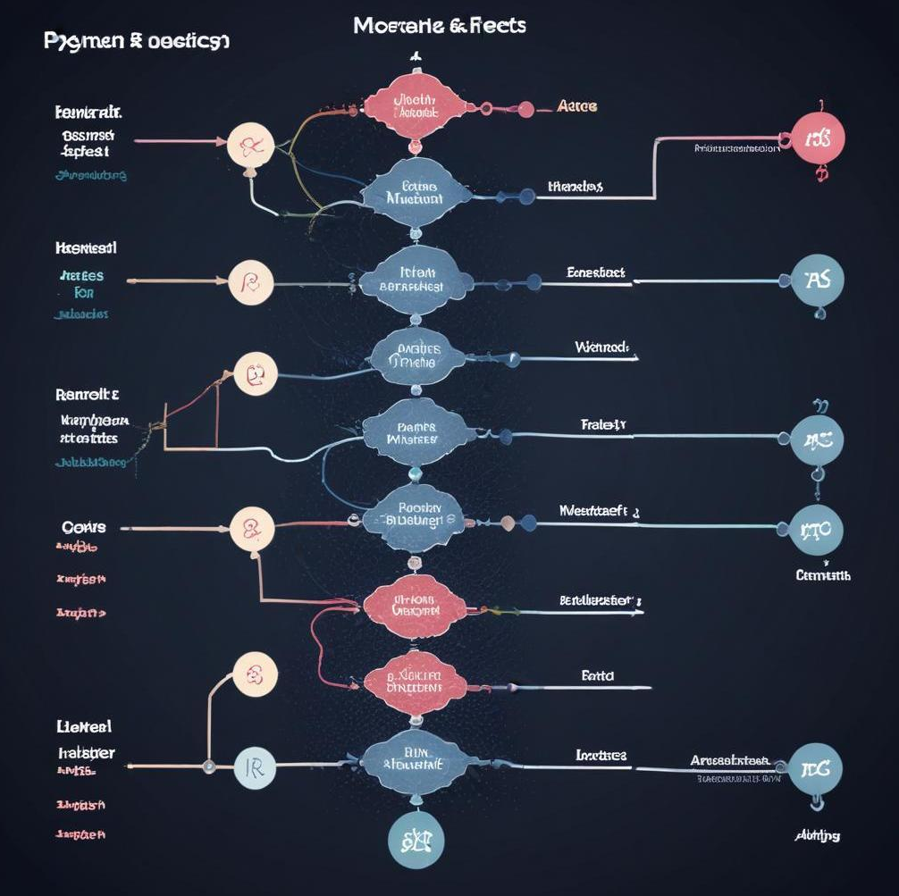
Mock Side Effects
Mock side effects allow you to define what happens when a mocked function is called, including raising exceptions or returning specific values. This is especially useful when simulating external services or complex business logic. By setting up side effects correctly, you can test how your code responds to various situations without executing the real implementation.

Slide 6
Context Managers vs Decorators
Context managers and decorators are both useful for managing setup and teardown in tests. Context managers provide a way to allocate resources and ensure cleanup using the 'with' statement, while decorators modify functions or methods, allowing for pre- and post-processing behavior. Understanding when to use each can enhance your test design and maintainability.

Slide 7
02
Fixtures

Slide 8
Setup and Teardown
Setup and teardown methods are essential for preparing the environment before tests and cleaning it up afterward. They help maintain isolation between tests, reducing dependencies on external resources. Utilizing these methods can ensure that each test runs in a controlled state, preventing interference and improving reliability.

Slide 9
Resource Management
Proper resource management in tests refers to efficiently allocating and releasing resources such as database connections, files, or temporary directories. By managing these resources, you can avoid resource leaks that could affect subsequent tests. Effective use of fixtures plays a crucial role in resource management by providing necessary setup and ensuring cleanup.

Slide 10

Cleanup Strategies
Cleanup strategies are designed to ensure that any resources used during a test are properly released or cleaned up afterwards. This prevents potential side effects that could impact other tests. Common cleanup techniques include utilizing teardown methods, context managers, or even specific cleanup functions that are registered to run after tests are complete.

Slide 11
03
Parameterized Testing

Slide 12
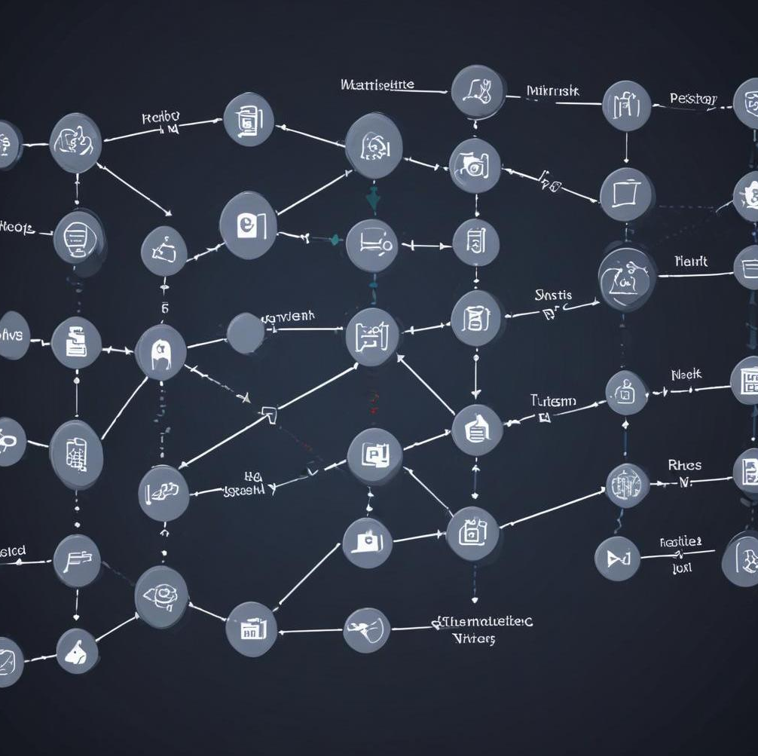
Using Data Providers
Data providers allow you to run the same test method with different inputs, creating a more efficient testing framework. This technique reduces redundancy in tests while ensuring extensive coverage by checking various scenarios in one go. Implementation typically involves decorators or specific libraries that facilitate the feeding of multiple data sets into your tests.

Slide 13
Dynamic Test Creation
Dynamic test creation is a powerful concept that allows tests to be generated at runtime, adapting based on the provided data points. By using loops or data-driven patterns, you can create new test cases programmatically according to your data set, enhancing maintainability and scalability of your test suite

Slide 14
Benefits of Parameterization
Parameterization leads to several advantages in testing, such as reducing code duplication, enhancing readability, and simplifying test maintenance. It helps maintain a single point of change when test logic is modified. Additionally, it improves the robustness of the test suite by allowing the testing of a wider variety of scenarios and inputs.

Slide 15
Async Testing
04

Slide 16
Handling Async Operations
Handling asynchronous operations in testing requires special techniques as tests can complete before the async code has finished. Using tools like 'asyncio' and appropriate test frameworks, you can await async functions within your test cases, ensuring they complete their operations before assertions are made, thereby improving accuracy in testing async behavior.

Slide 17

Testing Async Functions
Testing async functions involves ensuring that the functions behave as expected when they are awaited. This includes properly testing both the function’s return values and handling potential exceptions. To do this effectively, frameworks such as pytest and unittest provide specific syntax and mechanisms to integrate async code within traditional test structures.

Slide 18
Mocking Async Calls
Mocking async calls is essential when testing asynchronous functions that interact with external systems or APIs. By using libraries tailored for asynchronous testing, you can simulate responses from these calls without executing the actual logic. This allows for more controlled testing environments and the ability to test various scenarios without depending on external systems.

Slide 19
05
Coverage Metrics

Slide 20
Advanced Coverage Techniques
Advanced coverage techniques involve using specialized tools and configurations to obtain deeper insights into the effectiveness of tests. This may include branch coverage, path coverage, and measuring the execution of conditionals within the code. By analyzing coverage metrics, teams can identify untested parts of their codebase and improve their testing strategies.

Slide 21

Using Coverage Tools
Using coverage tools such as Coverage.py can help you monitor and report which parts of your program are executed during tests. By integrating these tools within your testing workflow, you can easily generate coverage reports and pinpoint areas of your code that require additional testing, leading to improved quality and robustness of your applications.

Slide 22
Interpreting Coverage Reports
Interpreting coverage reports involves understanding the data provided by coverage tools to identify areas for improvement in your test suite. Look for metrics such as coverage percentage, missed branches, and related statistics to assess your testing effectiveness. Actionable insights from these reports guide you on where to focus additional testing efforts.

Slide 23
Conclusions
In conclusion, advanced techniques in Python unit testing, including mocking, fixtures, parameterization, and coverage analysis, enhance test reliability and efficiency. Utilizing these strategies allows developers to create robust applications while ensuring high-quality code through comprehensive testing practices.

Slide 24
Thank you!
Do you have any questions?

